Slide 1
CIRSE 2027
Student Programme
MEET
SHARE
CONNECT
EXCHANGE
EDUCATE
SEPTEMBER 25-29 | MILAN, ITALY
be inspIRed ...
FUTURE OF MEDICINE
TEAMWORK
EXPERIENCE
INNOVATION

Slide 2

be inspIRed ...
7

Slide 3
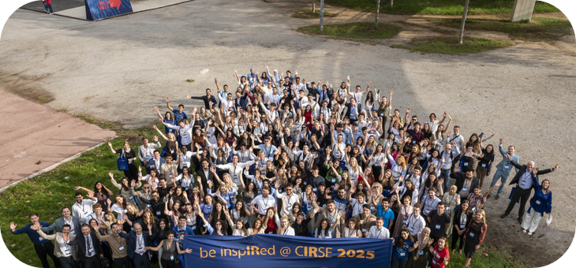
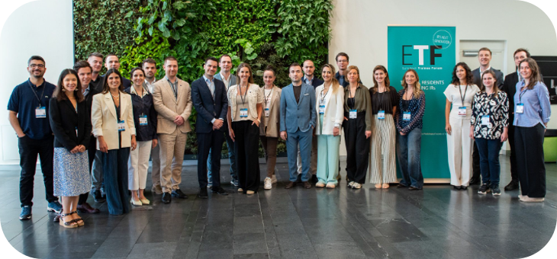
About CIRSE
And support IR’s next generation…
The Cardiovascular and Interventional Radiological Society of Europe (CIRSE) is a non-profit scientific, and educational society
1985
founded
10,000+
academic members
Medical students
OUR MISSION
Improve patient care through the support of education, science, research, and clinical practice in the field of IR
Residents, trainees, and junior IRs
Find out more at cirse.org
7

Slide 4








CIRSE Student Programme – What do we offer?
Student membership
Free registration for all CIRSE congresses (CIRSE, ECIO, ET)
Student internships at IR departments in Europe
Webinars on basic IR procedures
Research materials for students (reports, papers, and IR curricula)
Educational videos
Networking with junior and senior IRs
Joint activities and events with the CIRSE European Trainee Forum
Find out more at cirse.org/students
7

Slide 5



CIRSE student membership – join the CIRSE family!
What are the main benefits?
Eligibility criteria?
< 8 years
Be enrolled in your first undergraduate degree which must have started less than eight years ago
Free access to CIRSE’s official journals: CVIR, CVIR Endovascular, CVIR Oncology
Free video streaming via the CIRSE Library
Fast track registration for all CIRSE events
Find out more at cirse.org/students
7

Slide 6

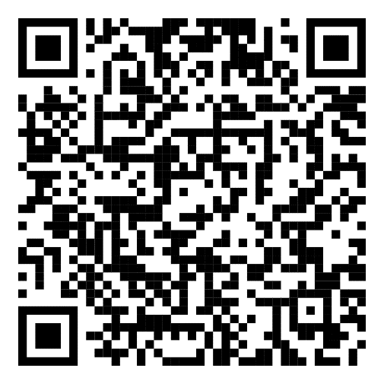
Access the CIRSE Library with your student membership!
Your student membership allows you to access all content in the CIRSE Library, including all lectures from webinars and CIRSE congresses.
Not sure where to start?
Check out the Student Programme sessions that are targeted at students who want to know more about interventional radiology
7

Slide 7


Student Programme at CIRSE 2027
1
Free congress registration + travel support grant
2
Introducing IR session
3
Recommended scientific sessions & talks
4
Student-exclusive HDT and simulation trainings
5
Workshops in cooperation with corporate partners
“This unique congress experience will provide you with educational, engaging & fun IR-related sessions and events!”
6
Students on stage session
7
Social events: Students’ meet & greet, Mentoring event, Students’ evening, Students’ quiz
8
Students’ section in the CIRSE Event App
7

Slide 8

Undergraduate medical students at CIRSE 2027
the first
Travel Support Grant
The first 200 students who successfully register for CIRSE 2027 have a chance to win a CIRSE travel support grant!
Visit cirse.org/students and learn more.
200
students
Any questions? students@cirse.org
7

Slide 9

Introducing IR session
SATURDAY · 08:30 – 09:30
7

Slide 10
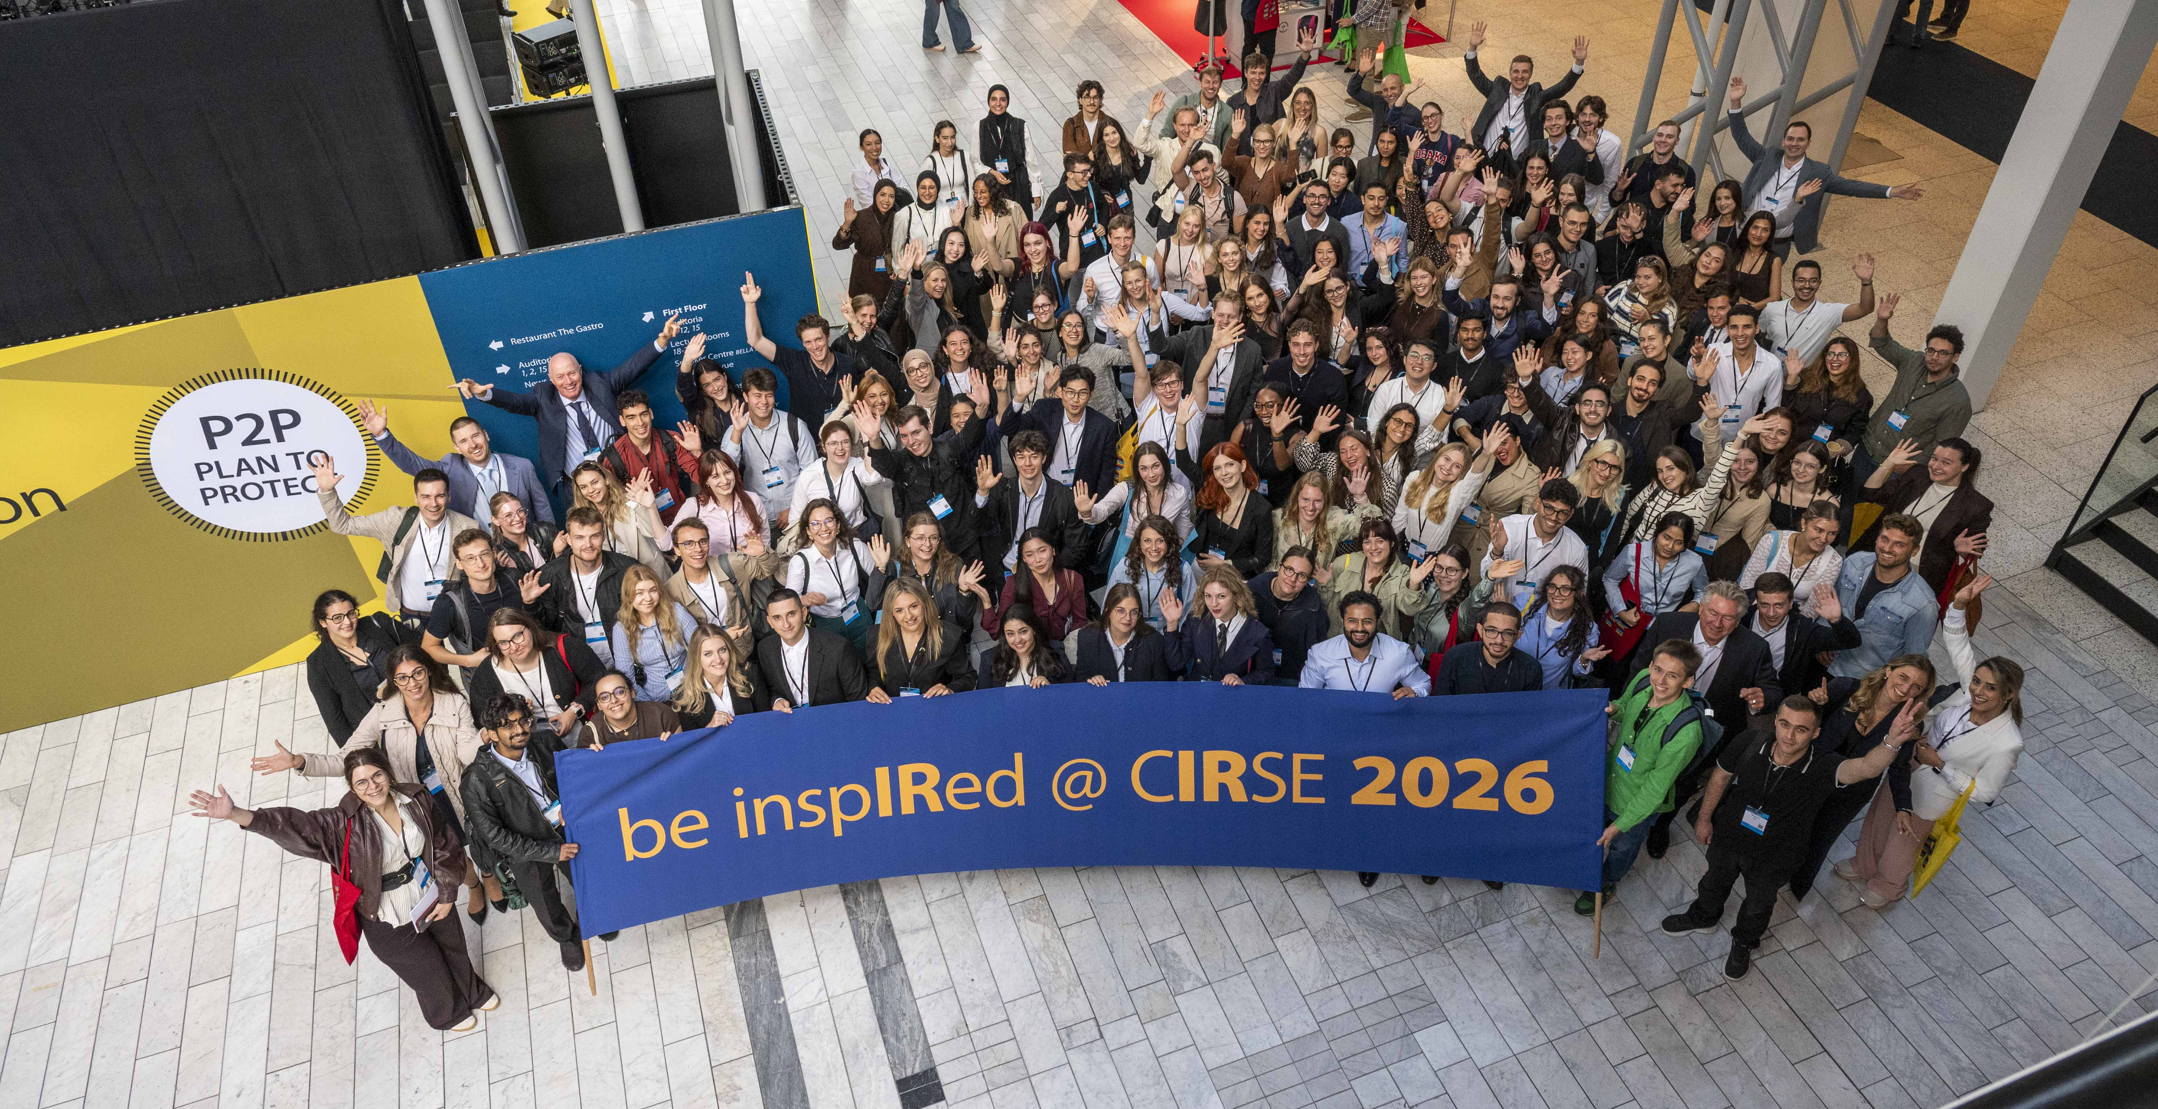
Students’ Meet & Greet
SATURDAY · 10:00 – 11:00
7

Slide 11
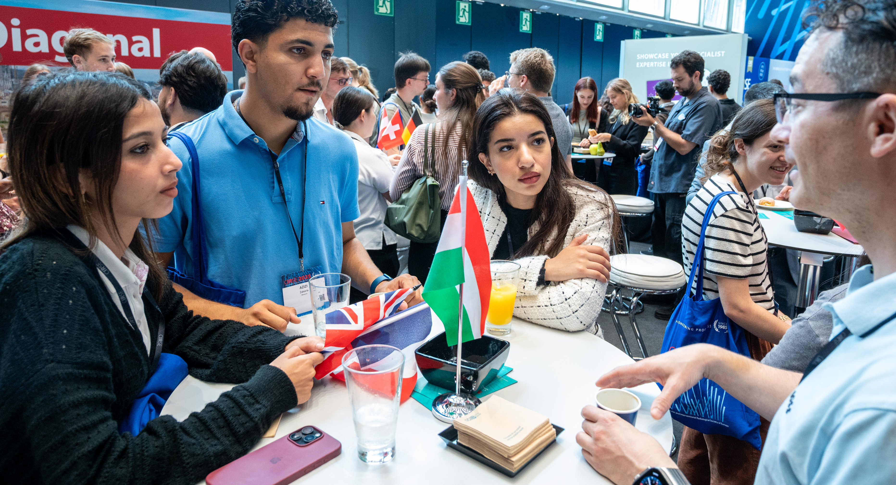
Mentoring event
SUNDAY · 10:00 – 11:00
7

Slide 12
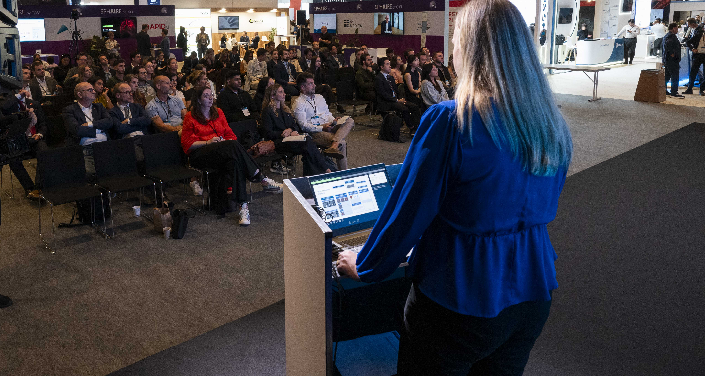
Students on Stage
MONDAY · 17:30 – 18:30
7

Slide 13
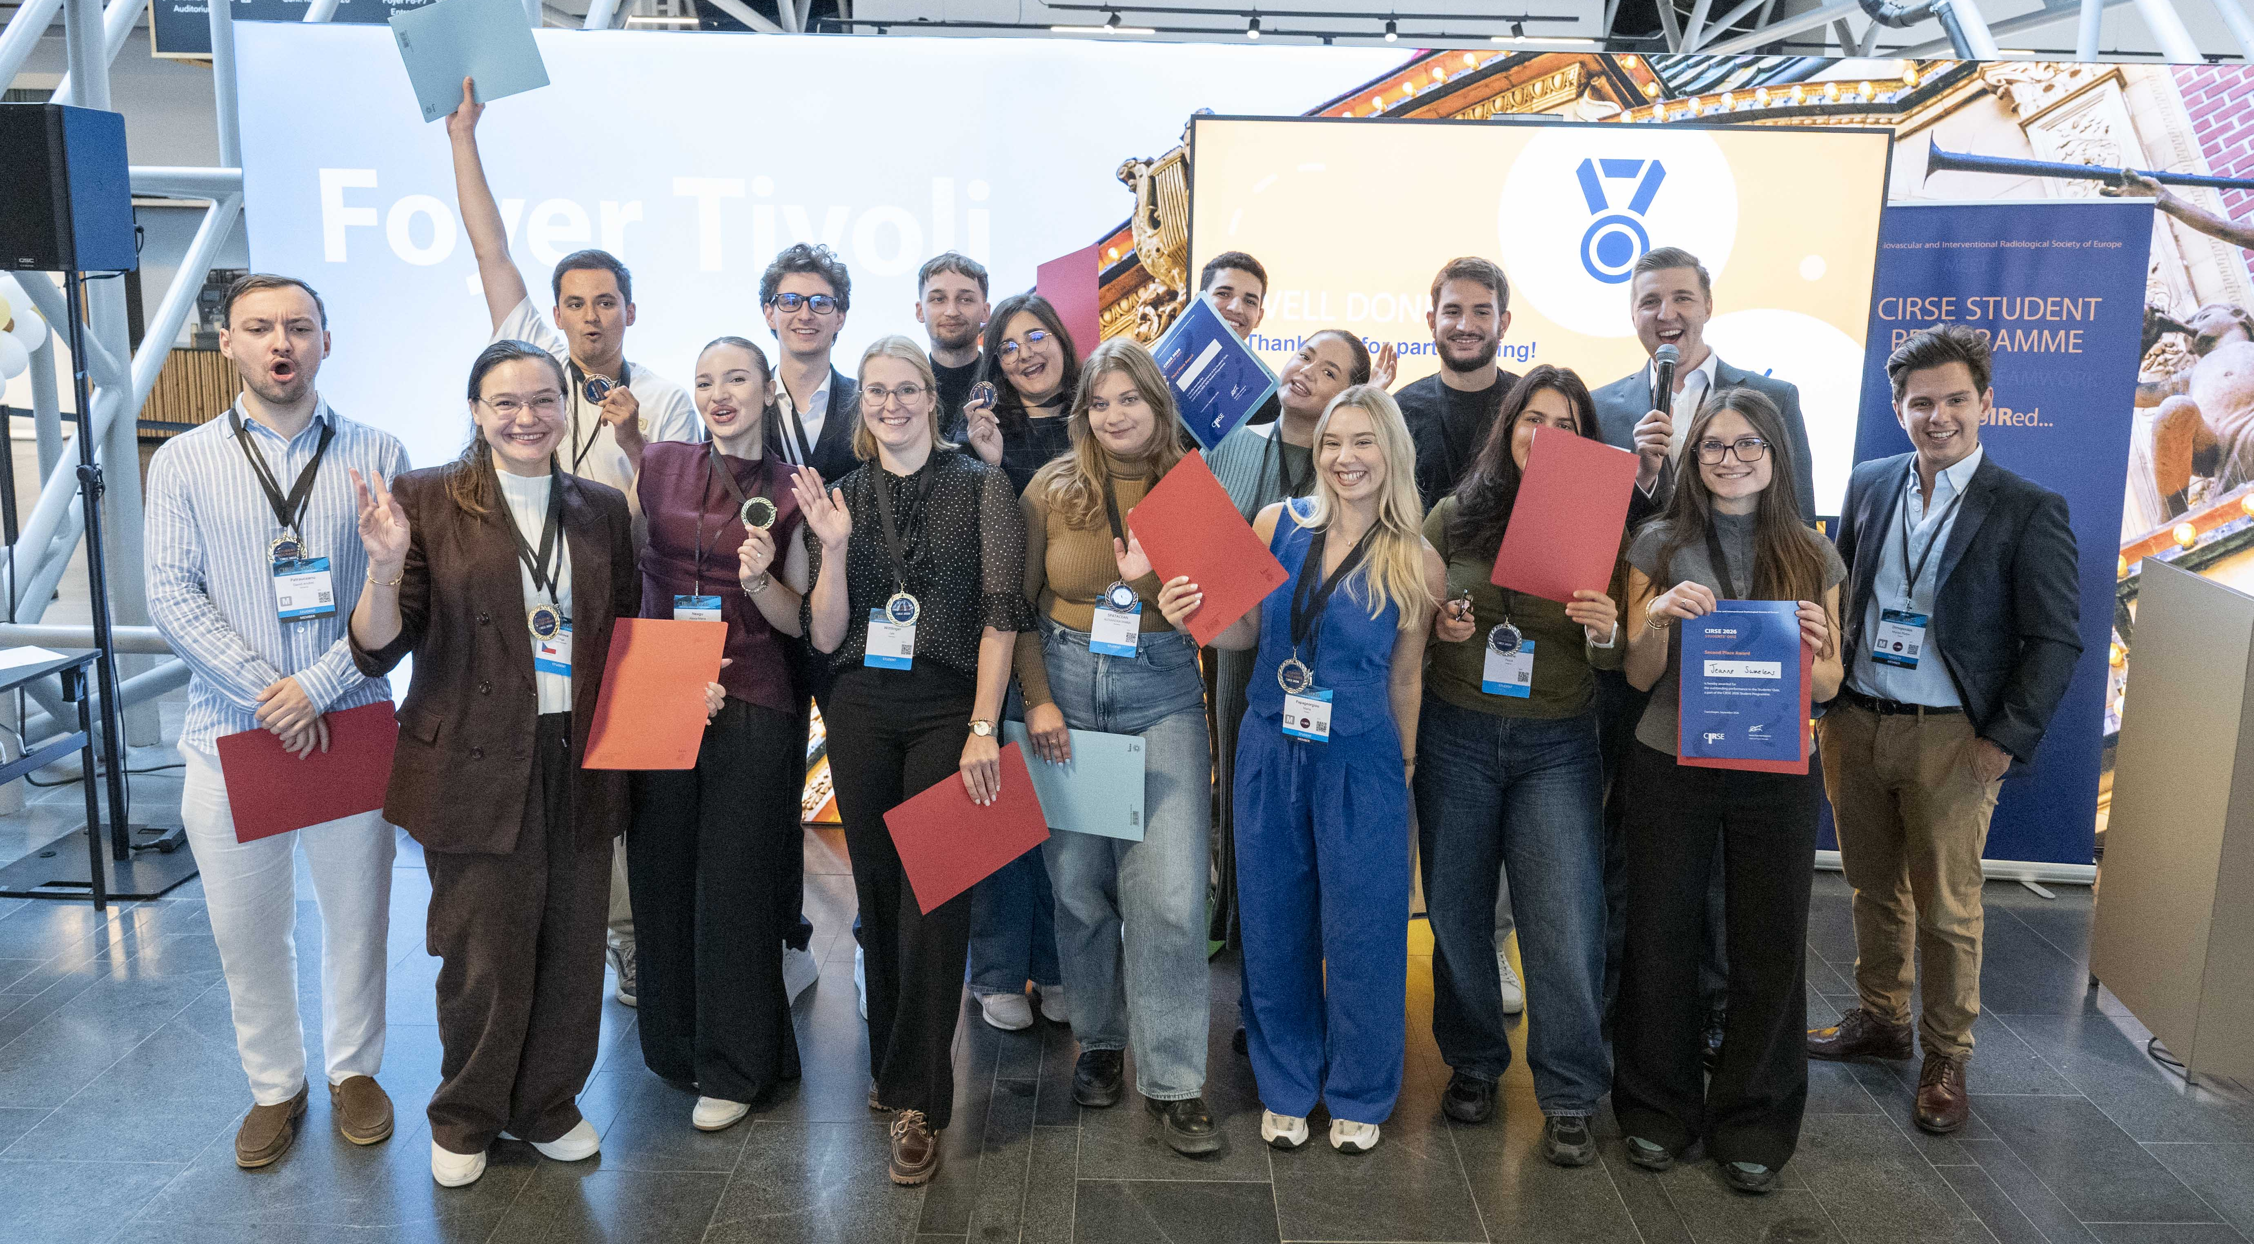
Students’ Quiz
TUESDAY · 12:00 – 13:00
7

Slide 14
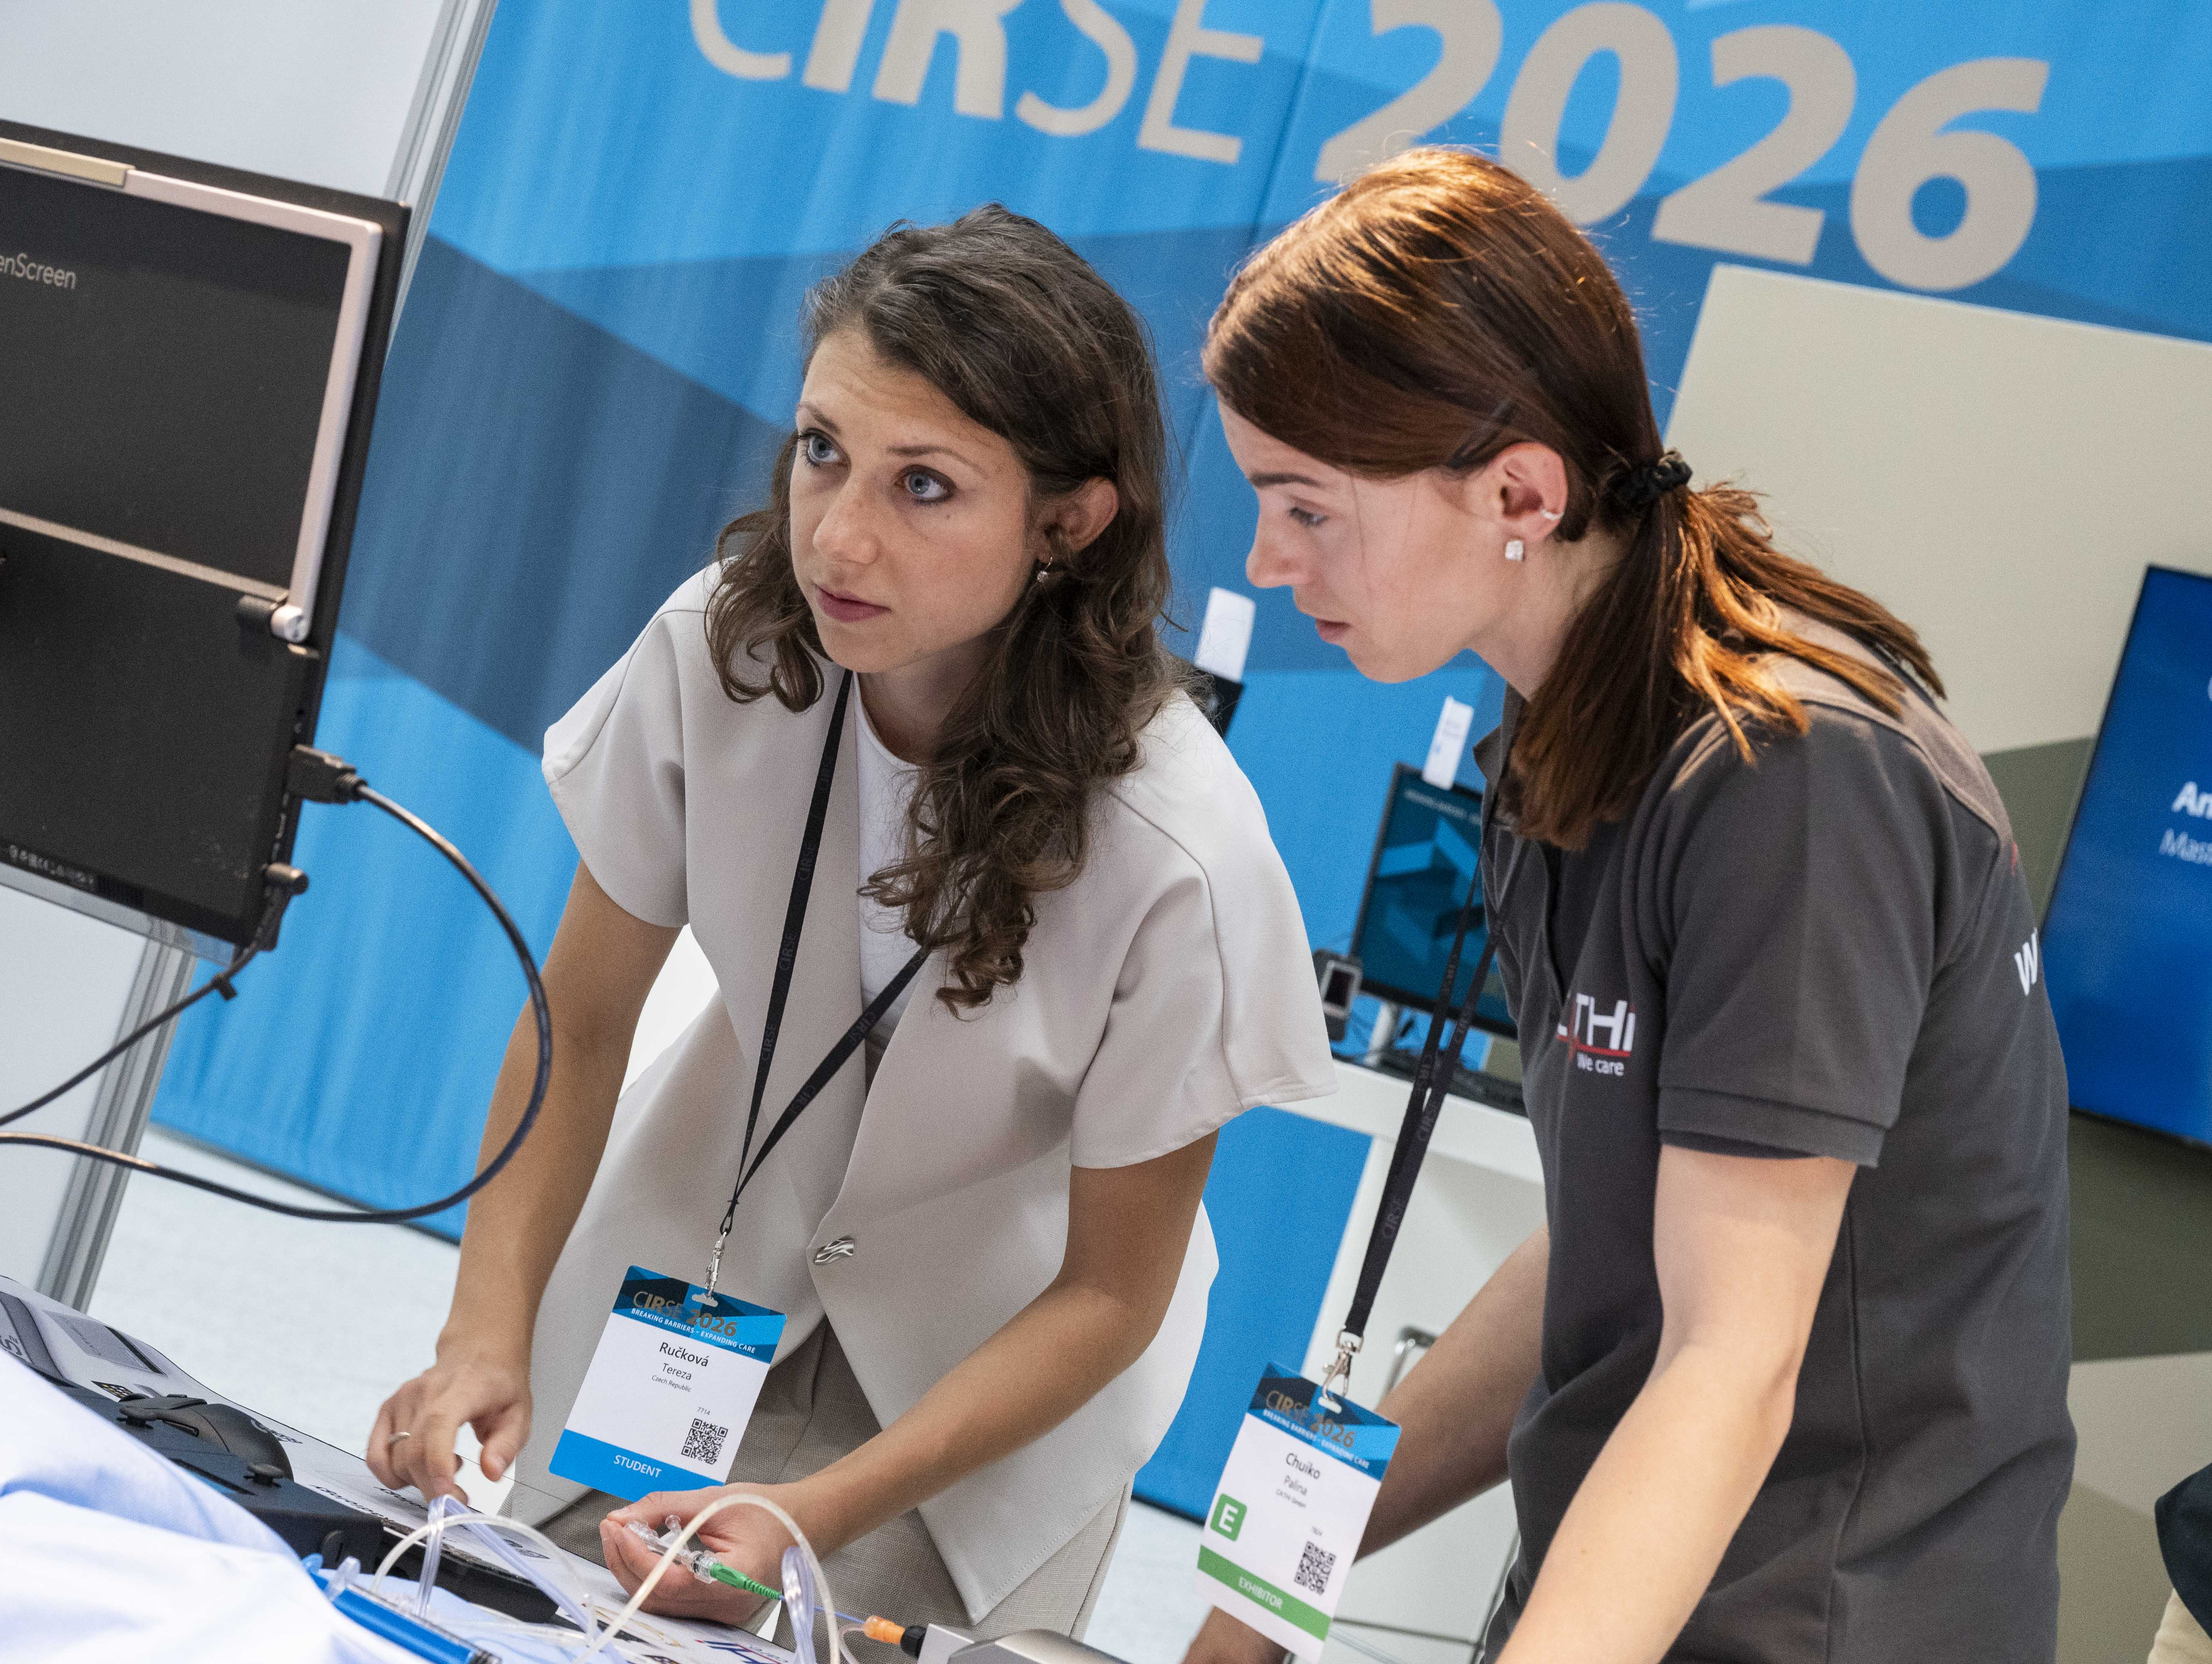
Hands-on device training
Saturday –
Tuesday
7

Slide 15







Why you should be a part of the CIRSE Student Programme?
Deepen your knowledge of IR
Introducing IR session
Get to know other medical students
Recommended scientific sessions & talks
Meet leaders in IR
Hands-on device training sessions
Learn different methods & possibilities of treatments through hands-on device training
Workshops by CIRSE corporate partners
Get inspired by different IR career paths
Social events (Mentoring event, Students’ evening, Students’ quiz)
7

Slide 16
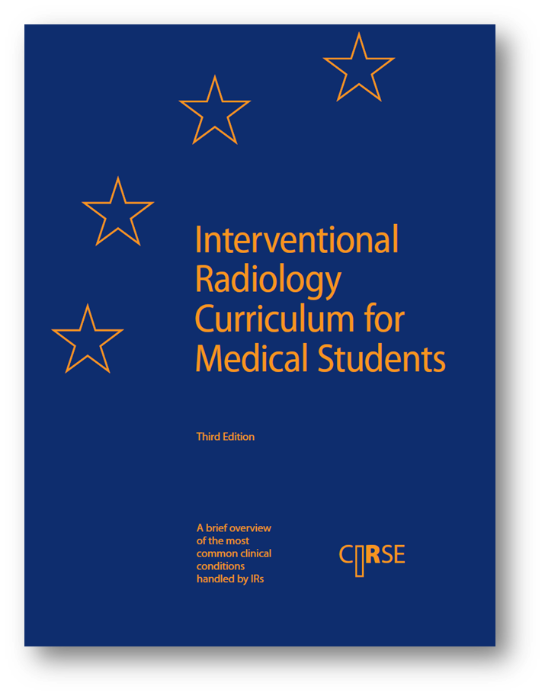
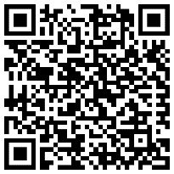
Interventional Radiology Curriculum for Medical Students
This curriculum is designed to make medical students aware of the ever-increasing role of interventional radiology in hospital medicine. It aims to support medical students planning on pursuing a career in IR and those who may participate in a multidisciplinary approach to patient care in the future.
Scan the code to download the curriculum for free at cirse.org
7

Slide 17
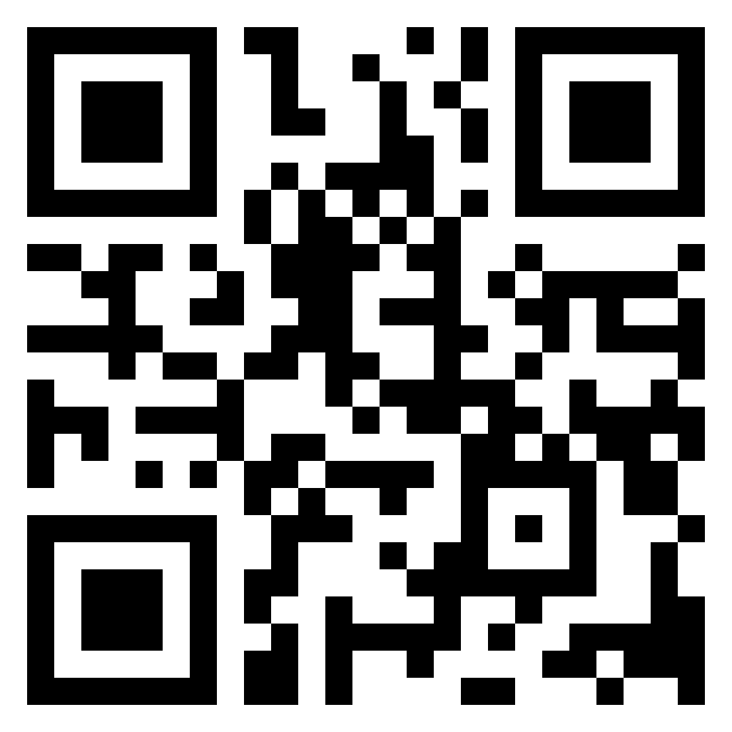

Scan the code to learn more
7

Slide 18






Follow us on social media!
Facebook – dedicated ETF page
Instagram – @cirse_students & @CIRSE_ETF
YouTube – watch the latest CIRSE videos @CIRSEsociety
Twitter/X – @ETF_IRtrainees
LinkedIn – Follow CIRSE and European Trainee Forum

