Slide 1
Clinical Services in Interventional Radiology (IR):
Advancing Patient-Centred Care

Slide 2
Overview
Interventional Radiology in a nutshell
IR as a cornerstone of modern clinical care
The value of a clinical IR service
Medical impact
Economic impact
Strategic impact

Slide 3
Interventional radiology in a nutshell

Slide 4
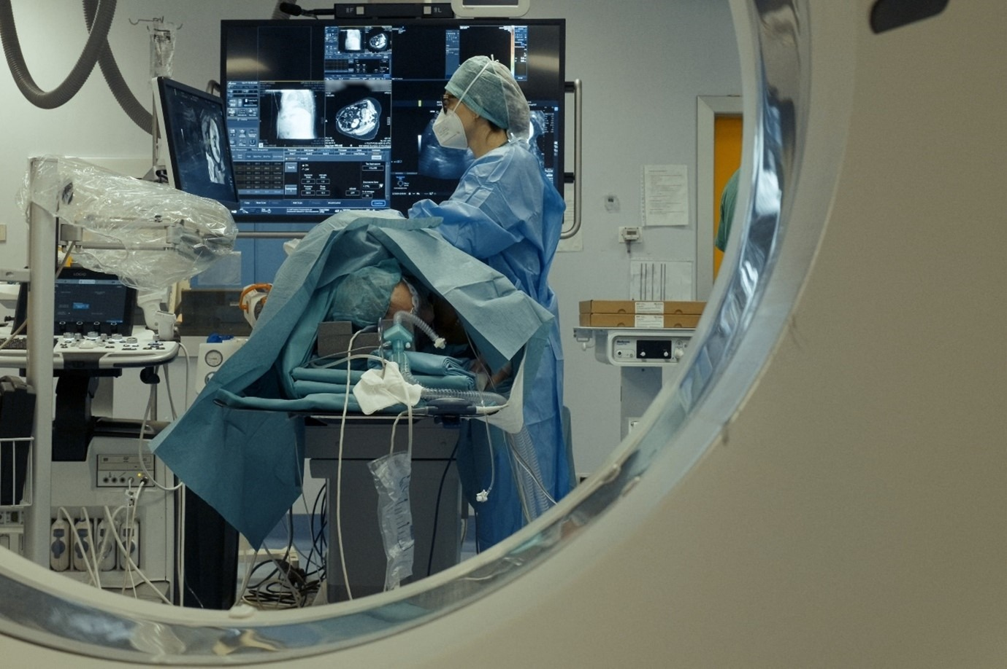
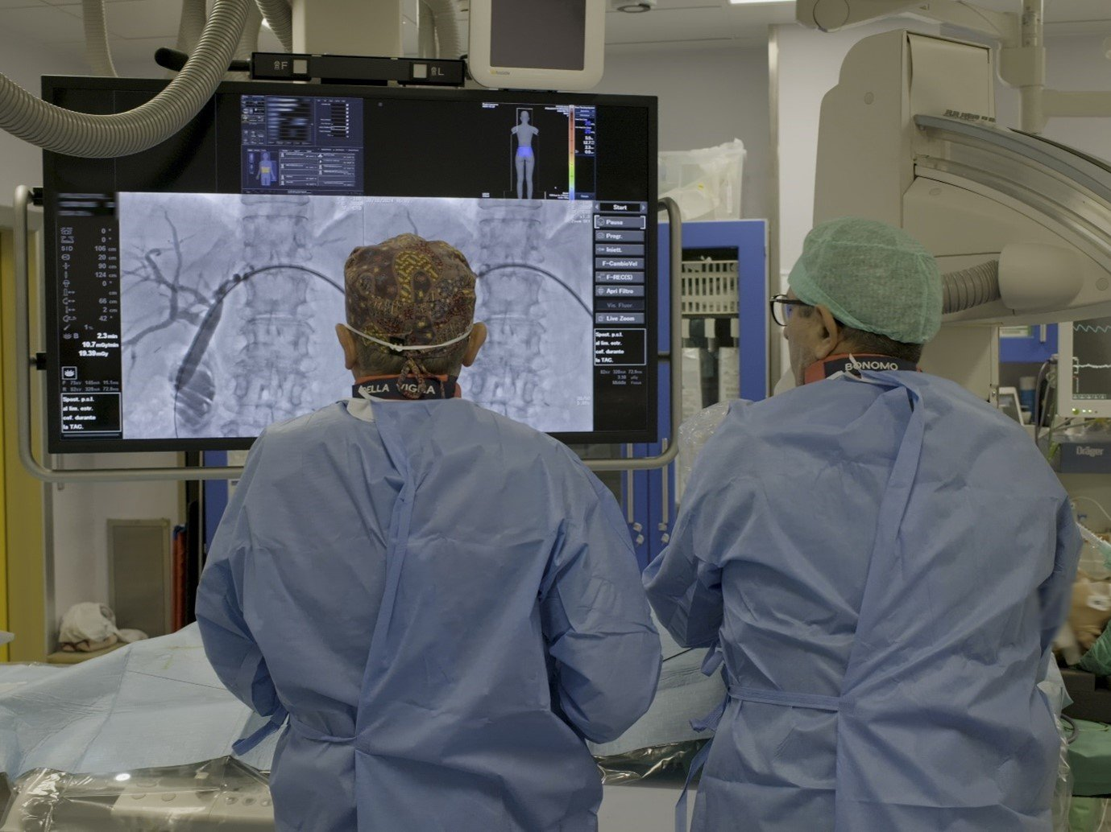
Interventional radiology in a nutshell
IRs are specialised in minimally invasive, image-guided treatments for a wide range of conditions as an alternative to traditional treatments.
Interventional Radiology is one of the most dynamic, innovative and rapidly growing areas in medicine.
IR therapies are suitable for virtually all parts of the human body, and an ever-growing area of indications.
Main areas include vascular procedures and interventional oncology treatments. The focus may vary depending on local practice, needs and expertise.

Slide 5
Campbell et al, Fontiers in Radiology, 2024

Slide 6
IR as a cornerstone of modern clinical care

Slide 7
IR as a cornerstone of modern clinical care
Historical focus:
IR initially centred around specific procedures requested by specialists
It is a subspecialty with a treatment focus
Modern IR practice:
IR is a fully clinical discipline
Interventional Radiologists oversee all aspects of patient care:
→ review history, examine patients, diagnose, plan management, and arrange follow-up
IR refer to other disciplines as required
Involving clinical in-patient consultations and out-patient clinics
Patients are referred directly to Interventional Radiologists
IRs see patients referred from GPs

Slide 8
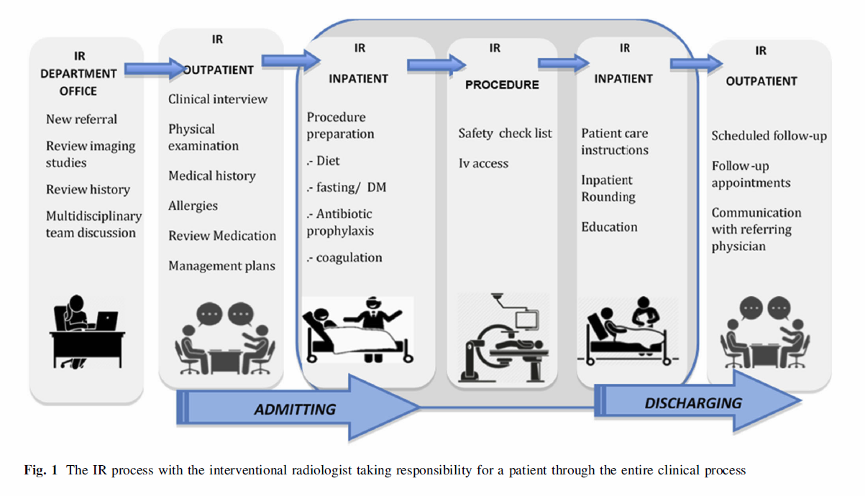
IR as a cornerstone of modern clinical care
The interventional radiologist is responsible for continuity of care throughout the patient journey
Mahnken A. et al., Cardiovasc Intervent Radiol (2021).

Slide 9
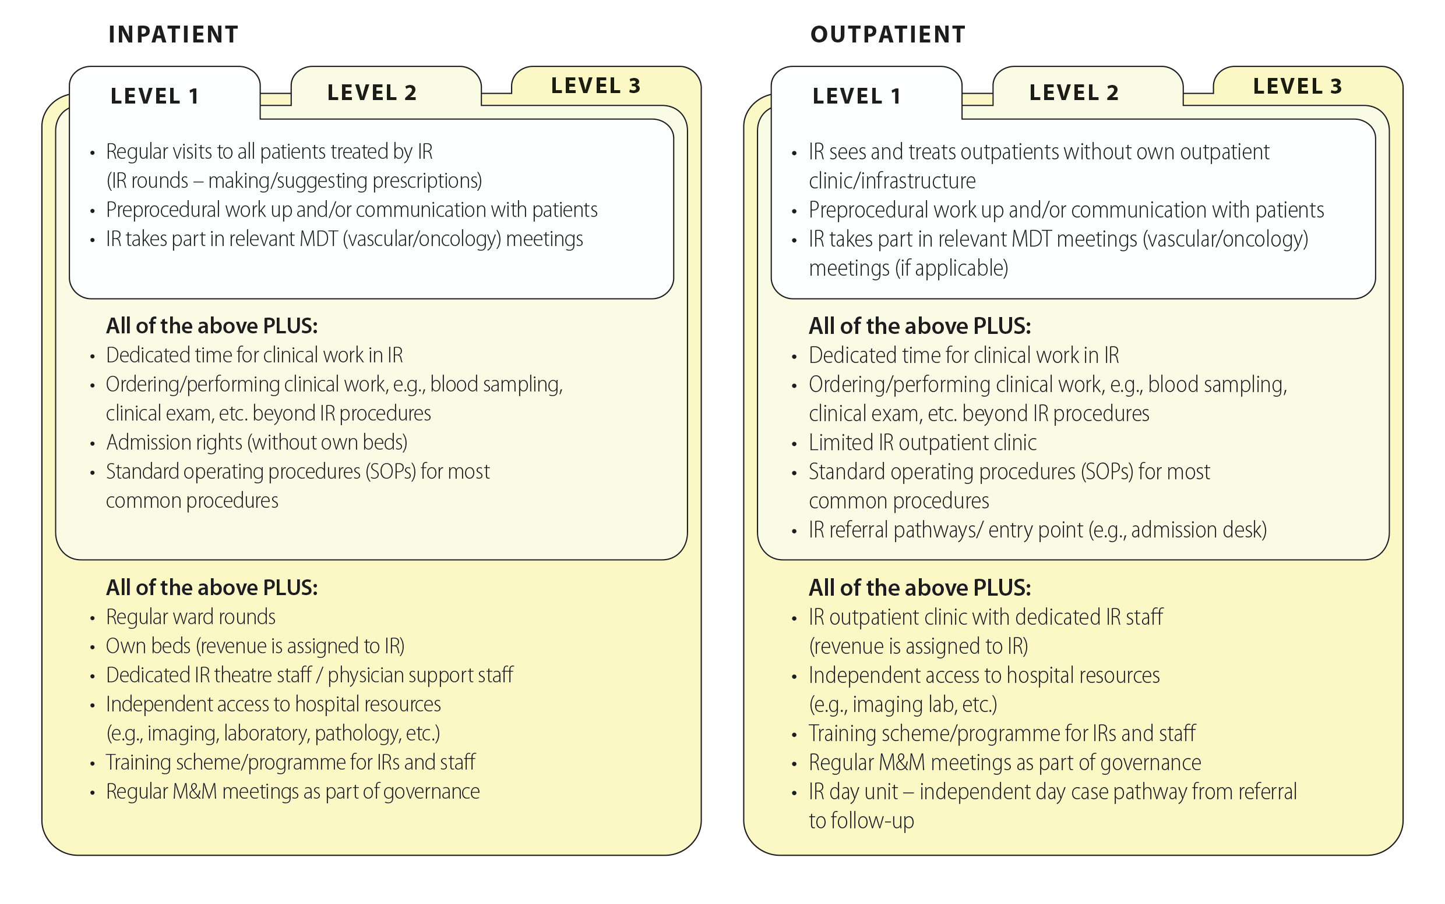
Development of clinical IR services: a growth perspective
Ryan A. et al., Cardiovasc Intervent Radiol (2024).

Slide 10
The value of a clinical IR service
Medical impact

Slide 11

Medical impact
Clinical IR services...
...enhance patient-centred care by promoting effective communication through consultations and improved decision-making
...lead to optimal treatment selection and higher patient satisfaction
...improve access to minimally-invasive treatments
...enable faster diagnosis and therapeutic pathways
...expand therapeutic options for patients
...allow shorter hospitalization times or even ambulatory care

Slide 12
Improving access to minimally-invasive care
Increasingly, patients express a preference for minimally invasive treatments
IR is offering multiple minimally invasive alternatives to traditional procedures
Examples:
Locoregional treatment of malignant neoplasms.
Treatment of uterine myomas
Treatment of varicocele
Treatment of benign prostatic hyperplasia.
Direct patient access to IR through the out-patient clinics and increased clinical exposure of interventional radiologists results in better access to these minimally invasive procedures
Result: faster recovery => shorter hospitalization times => higher patient throughput

Slide 13
Faster cancer diagnostic and therapeutic pathways
IR represents an important role in the modern cancer care (Interventional Oncology).
Plays a pivotal role in expediting cancer diagnostic and therapeutic pathways:
Diagnostics: biopsy
Therapeutic: local ablations, chemo- and radioembolization…
Palliative/supportive care: gastrostomy, ports…
Provision of clinical support: Complication management, percutaneous drainages
Active participation in Multidisciplinary tumour boards
Benefits of clinical approach in cancer patients:
Faster access to necessary procedures
Minimize delays in cancer care
Offers patient-centric approach

Slide 14
Expanding therapeutic options for patients
Supporting the development of clinical IR practice increases the visibility of IR
Increased visibility and understanding by other clinical specialties of treatments offered by IR expands therapeutic options, particularly for high-risk patients, where IR procedures offer a less invasive alternative to potentially more morbid traditional procedures
Examples:
Endovascular aortic aneurysm repair (EVAR) versus open AAA repair
Percutaneous tumor ablation versus surgical resection
Percutaneous abscess drainage versus open washout
Embolization versus surgical packing in abdominal bleeding
These treatment options may already be available, but could be underutilised due to “low visibility”
Results: improved efficiency, reduced need for intensive care unit (ICU) and high-dependency unit (HDU) admissions

Slide 15
The value of a clinical IR service
Economic impact

Slide 16
Economic impact
Clinical IR services...
... help to optimize patient selection and shorten total treatment times by integrating day-care treatments and outpatient clinics
... reduce the pressure on inpatient beds
... streamline pathways and facilitate efficient interventions
... allow to offer a wider range of treatment options
... thereby increase overall patient throughput
... and optimise hospital resources through fiscal accountability

Slide 17
Transforming towards a clinical IR service
Clinical IR transformation has many benefits:
Shortening the patient treatment times=higher patient throughput*
Optimising hospital resources
Improving patient-centred care with personalised medicine in a modern hospital
However, it may represent initial re-organisation and investment :
People - dedicated IR staff (incl. nurses, radiographers, administrative staff)
Space - clinic room, IR day unit, IR ward
Time - dedicated time for IR clinical activity

Slide 18
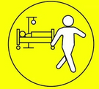
Increasing day-case procedures
Clinical practice in IR facilitates the performance of a vast majority of treatments on a day-case basis
Higher patient turnover with fewer complications¹
Minimally invasive IR procedures performed under local anaesthesia and sedation are ideally suited for day case pathways
IR can be combined with other treatments or may offer additional therapeutic options
1 - Roson, N. et. al., Insights Imaging 13, 109 (2022).

Slide 19
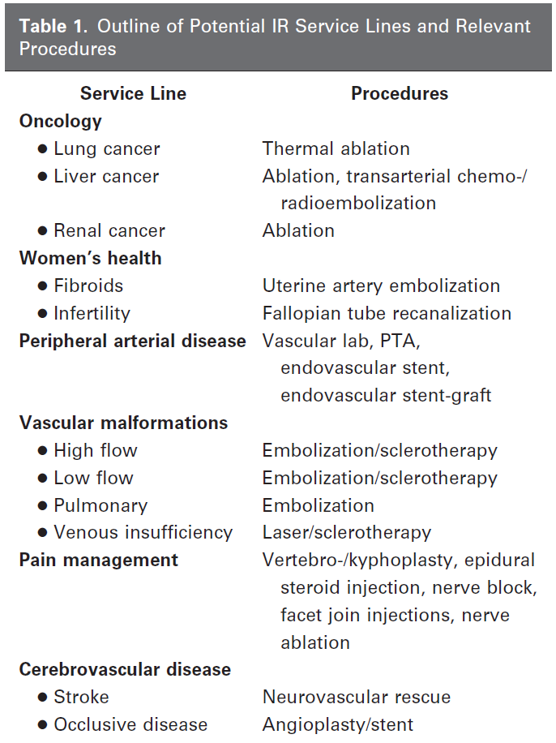
Increasing day-case procedures
IR allows for a broad range of service lines (table)
Results:
Efficient resource utilization: Day case procedures reduce pressure for inpatient beds
Cost savings: Reduced in-patient bed stay lead to substantial cost savings²
Enhanced patient satisfaction: Patients benefit from faster recovery and improved quality of life^{3,4}
2 - Makris GC. Et al., Clin Radiol. 2016 Jul;71(7):716.e1-6.
3 - Cazzato RL et al., Cardiovasc Intervent Radiol. 2021 Jan;44(1):118-126.
4 - Lutjeboer et sl., Cardiovasc Intervent Radiol. 2015 Jun;38(3):543-51.
Beheshti M.V. et al., J Vasc Interv Radiol 2012; 23:1181–1186

Slide 20
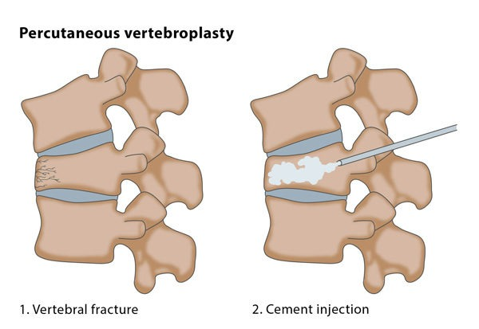
Exemplary business case: Osteoporotic fracture management
Why it matters:
Osteoporotic vertebral fractures (OVFs) lead to severe pain, immobility, and extended hospital stays.
IR procedures like vertebroplasty and kyphoplasty offer rapid pain relief and quicker mobilization.
Minimally invasive, often performed as day-case or short-stay procedures under local anesthesia.
Reduces opioid use, complications, and long-term care burden.
Clinically effective and efficient, especially beneficial for elderly patients.
“Kyphoplasty significantly shortens hospital stay and improves early mobility¹.”
1 - Klazen et al., Lancet 2010
Image source: https://www.cirse.org/patients/general-information/ir-procedures/vertebral-augmentation/

Slide 21
Exemplary business case: Osteoporotic fracture management
Historically:
Elderly patients with spinal fractures admitted for 7–10 days.
Managed conservatively: high pain scores, prolonged rehabilitation, high cost (~€4,000–6,000 per admission)¹.
After introducing IR vertebral augmentation:
Same-day or next-day procedure.
Discharge within 24–48 hours.
Cost per case: ~€2,000–3,000¹.
Estimated savings: €1,500–3,000 per patient¹.
Higher throughput, better outcomes, lower readmission rates.
Bed-day savings, improved patient satisfaction and revenue opportunity
1 - Pron G et al., BMJ Open. 2023

Slide 22
Exemplary business case: venous access
Why it matters:
Steady increase in the use of totally implantable venous access devices, i.e. for oncologic but also other patients
Minimally invasive placement under image guidance since the 1990s, related to lower costs and shorter operating times, higher technical success rates and reduced morbidity.
Large comparative studies of costs and outcomes of surgical vs IR placement ^{1,2}:
Overall mean costs for chest port insertion were significantly higher in the OR, for both room and pharmacy costs
Lower rates of adverse events and follow-up procedures for IR
Significant differences in insertion cost suggest more cost-effective IR placement than surgical placement without affecting quality
1 – Martin B., et al, J Vasc Interv Radiol 2022; 33:1184–1190
2 - LaRoy J.R., et al, J Am Coll Radiol 2015;12:563-571.

Slide 23
Competitive advantages of IR clinics
Effects of establishing an IR clinic¹
Increase volume of patients
Reduce avoidable costs
Improve efficiency of machines used
By proper selection an HCP can add profitable IR services to their portfolio
1 – McDevitt et al., J Clin Interv Radiol, 2021.
Notes:
IR and financial value

Slide 24
Competitive advantages of IR outpatient clinics
Outpatient IR clinics are key to assessing patient suitability for procedures
IR clinic appointments ensure appropriate counselling, informed consent and follow-up
Advantages of IR clinics:
Resource optimization by appropriate patient selection and therefore avoiding cancellations
Streamlined patient pathways from admission to discharge report
Continuity of care by responsible IR clinician enhances overall patient experience
Appropriate post-procedural care and identification of potential complications
Improved patient satisfaction¹
1 – Cazzato RL et al., CVIR, 2021

Slide 25
Competitive advantages of IR outpatient clinics
IR offers easy access to advanced treatment options via outpatient clinics
Embracing IR practice provides a competitive advantage by offering a wider range of services
Example: Prostate artery embolization¹
minimally invasive procedure for the treatment of the Benign prostate hypertrophy (BPH).
Expands the array of options for the treatment of BPH (medical and surgical)
Physicians can tailor BPH treatment for individual, according to their preferences
Result: Healthcare providers offering a wider range of treatment options attract a higher volume of patients seeking cutting-edge therapy. In addition, the recruitment and retention of highly skilled medical professionals is improved.
1 - Müllhaupt G et al., Eur Urol Focus 2024

Slide 26

Fiscal accountability
Budget Accountability:
Departmental budget control leads to better resource utilisation.
Departmental budget control leads to proactive cost management.
Departmental budget control motivates improved billing.
Fiscal Discipline:
Budget control leads to enhanced fiscal discipline
„A meta-analysis found that empowering employees by delegating authority and decision-making can lead to positive outcomes, including improved financial performance, when done correctly“
Notes:
*proof of concept from economical/business field

Slide 27
The value of a clinical IR service
Strategic impact

Slide 28
Strategic impact
Clinical IR services...
... increase efficacy of interdisciplinary decision-making
... expand treatment options for other disciplines with reduced complication rates and improved outcomes
...saves lives in emergency cases
... improve efficiency, reduce transfer costs, keep complex emergencies in-house, and enhance centre reputation when offered on a 24/7 basis

Slide 29

Increased efficacy of interdisciplinary decision making
IR clinical practice increases visibility of the hospital and trust among other clinical specialties
Increased visibility can enhance the integration of IR into the broader healthcare landscape
This fosters interdisciplinary communication and collaboration, providing a more streamlined approach to patient care
Results:
Optimising patient treatment pathways
Better patient care
More efficient resource allocation

Slide 30
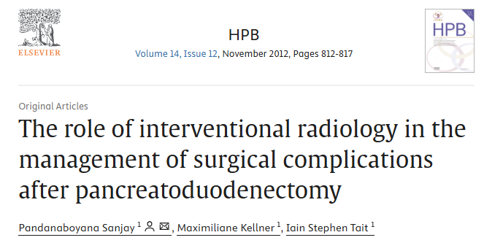
IR Enabling Complex Surgery: The Case of Pancreatic Surgery
Pancreatic surgery depends on IR support to ensure safe outcomes:
Post-op complications (abscesses, hemorrhage, bile leaks) are often managed non-operatively with IR
IR procedures like percutaneous drainage and embolization reduce the need for reoperation
Pre-op IR interventions (e.g. portal vein or biliary stenting) enable resectability
Minimally invasive IR options lower morbidity, shorten recovery, and improve patient flow
Additional treatment options for non-surgical candidates and additional revenues for the HCP– e.g. Electrochemotherapy
IR expands treatment options, reduces complications, and improves outcomes
“21/24 major post-op complications were successfully treated with IR. Reoperation rate: just 2.5%.” — Pandanaboyana et al., HPB (Oxford), 2013

Slide 31
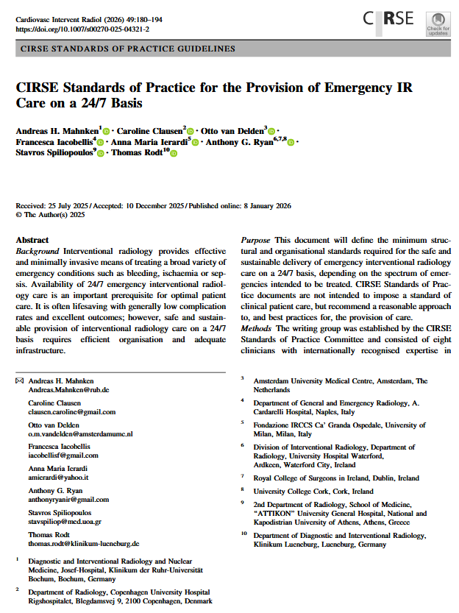
Emergency IR: 24/7 care saves lives
IR is essential in life-threatening emergencies¹:
Haemorrhage control: GI bleeding, trauma, post-partum haemorrhage
Infections: Urgent drainage of abscesses, obstructed kidneys
Ischemia: limb salvage in critical limb ischemia
Stroke: Mechanical thrombectomy for large vessel occlusion
Aneurysms: Endovascular repair of ruptured aortic aneurysms
Available 24/7, IR improves survival, avoids ICU stays, and reduces complications^{2,3}
1- Mahnken A., CVIR, 2026
2 - Uberoi R; Interventional News, 2016
3 - Chung R, CVIR Endovasc 2018

Slide 32
Why Hospitals Need 24/7 IR Coverage
Administrative case for round-the-clock IR:
Meet regulatory standards: Required for trauma & stroke center status
Improve efficiency: Fewer emergency surgery, shorter hospital stays
Reduce transfers: Keeps complex cases in-house
Strategic value: Builds reputation as a centre for comprehensive hyperacute and acute care
Patient safety: Availability of an 24/7 IR service saves lives¹
Investing in 24/7 IR = improved outcomes + cost savings + strategic advantage
1 - The Royal College of Radiologistst 2017, Ref No. BFCR(17)1

Slide 33

More resources on Clinical Services in IR
Visit www.cirse.org/clinicalservices

