Slide 1
Interventional radiology (IR)...
IR is a sub-specialty of radiology that has become increasingly important since the mid-1970s
Specialises in minimally invasive, image-guided treatments for a wide range of diseases
Gentle alternative to traditional surgical procedures
One of the most dynamic, innovative, rapidly growing areas in medicine
Click here to watch the video!

Slide 2
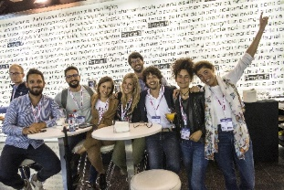
About CIRSE…
A non-profit, scientific and educational society founded in 1985
A global network and community of over 44,000 health care professionals, with over 8,600 academic members
Aims to improve patient care through the support of education, science, research, and clinical practice in the field of IR
Supports IR’s next generation…
Medical students
IRs in training
Find out more at cirse.org

Slide 3
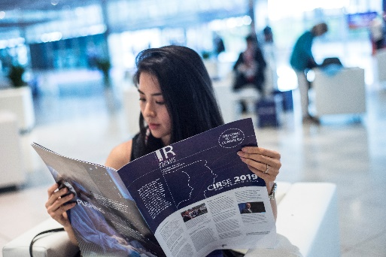
CIRSE’s activities for medical students…
Offering student membership category
Free congress registration to all CIRSE meetings (CIRSE, ECIO, ET)
Offering student internships at IR departments in Europe
Organising educational webinars on basic IR procedures
Publishing reports, papers and IR curricula
Creating educational videos
Connecting medical students with junior as well as senior IRs
Organising joint activities and events with the CIRSE European Trainee Forum
Find out more at cirse.org/students

Slide 4
CIRSE student membership – join the CIRSE family!
What are the main benefits?
Free access to CIRSE’s official journal, CVIR
Free video streaming via the CIRSE Library
Free purchase of the CIRSE Academy online courses
Fast track registration for all CIRSE events
What are the eligibility criteria?
To be enrolled in the first undergraduate degree that started less than 8 years ago
Apply for CIRSE student membership at cirse.org/students/cirse-student-membership/
…all this just for EUR 40/year
Follow CIRSEstudents on Facebook

Slide 5
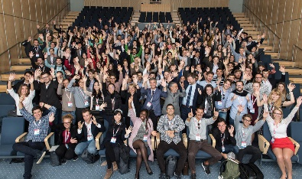
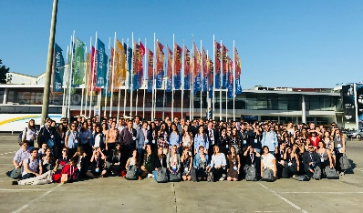
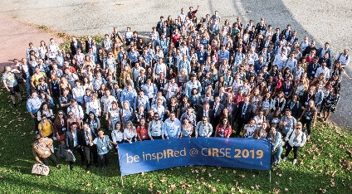
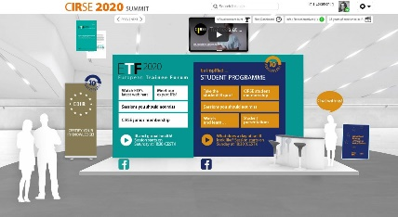
CIRSE’s Student Programme – be inspIRed!
Provides medical students with free congress registration for CIRSE Annual Meetings
Guides students through their congress experience and provides educational, engaging & fun IR-related sessions and events
Offers many events and sessions tailored specifically for medical students
2,200 medical students from all over the world participated in the programme since 2010
CIRSE 2017
CIRSE 2018
CIRSE 2019
CIRSE 2020 - online

Slide 6
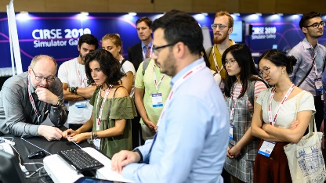
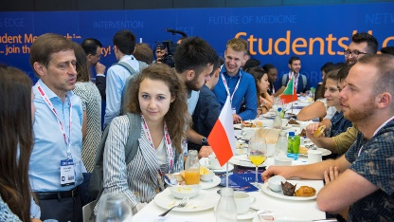
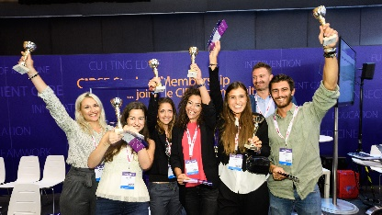
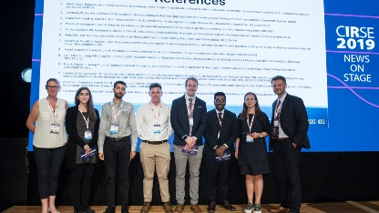
Why should you attend the CIRSE Student Programme?
Deepen your general knowledge of IR
Get to know other medical students
Meet leaders in IR
Learn different methods & possibilities of IR practice
Get inspired by different IR career paths
Be inspIRed at #CIRSE2021 (September 25-28) and register for the event now!

